Slide 1

Deep Neural Network
DSE Module 1
BITS Pilani

Slide 2
The Lecture Materials gratefully acknowledge the authors who made their course materials freely available online.

Slide 3
Course Logistics

Slide 4
What we Learn…. (Module Structure)
Fundamentals of Neural Network
Multilayer Perceptron
Deep Feedforward Neural Network
Improve the DNN performance by Optimization and Regularization
Convolutional Neural Networks
Sequence Models
Attention Mechanism
Neural Network Search
Time series Modelling and Forecasting
Other Learning Techniques
Notes:
Talk about each topic in 1 or 2 sentences.

Slide 5
Books
Textbook
Dive into Deep Learning by Aston Zhang, Zack C. Lipton, Mu Li, Alex J. Smola. https://d2l.ai/chapter_introduction/index.html
Reference book
Deep Learning by Ian Goodfellow, Yoshua Bengio, Aaron Courville https://www.deeplearningbook.org/
Notes:
The text book is freely available for download

Slide 6
Evaluation Components and Schedule
 | Evaluation Component | Mode | Duration | Weightage | Date and Time
EC1 | Quiz I* | Online | 30 Mins | 10% | Refer to LMS
 | Quiz II* |  | 30 Mins | 10%
 | Assignment 01 |  | 4 Weeks | 10%
 | Assignment 02 |  | 4 Weeks | 10%
EC2 | Mid-sem exam (Closed book) |  | 2 Hours | 30%
EC3 | Comprehensive exam (Open book) |  | 2.5 Hours | 40%
* Best of Two

Slide 7
Lab Sessions
L1 Introduction to PyTorch
L2 Deep Neural Network with Back-propagation and optimization
L3 CNN
L4 RNN
L5 LSTM
L6 Auto-encoders

Slide 8
Course Logistics
Refer Taxila for the following
Handout
Schedule for Webinar
Schedule of Quiz, and Assignments.
Evaluation scheme
Session Slide Deck
Demo Lab Sheets
Quiz-I, Quiz-II
Assignment-I, Assignment-II
Sample QPs
Lecture Recordings
Available on Microsoft teams

Slide 9
Honour Code
All submissions for graded components must be the result of your original effort. It is strictly prohibited to copy and paste verbatim from any sources, whether online or from your peers. The use of unauthorized sources or materials, as well as collusion or unauthorized collaboration to gain an unfair advantage, is also strictly prohibited. Please note that we will not distinguish between the person sharing their resources and the one receiving them for plagiarism, and the consequences will apply to both parties equally.
In cases where suspicious circumstances arise, such as identical verbatim answers or a significant overlap of unreasonable similarities in a set of submissions, will be investigated, and severe punishments will be imposed on all those found guilty of plagiarism.

Slide 10
In case of Queries regarding the course….
Step 1: Post in the discussion forum.
Read through the existing post and if you find any topic similar to your concern, add on to the existing discussion.
Avoid duplication of queries or issues.
Step 2: Email the IC at srinath.naidu@pilani.bits-pilani.ac.in if the query or issue is not resolved within 1 week. Turn around for a response to the email is 48 hours.
In the subject pl mention the phrase ”Deep Learning” clearly.
Use BITS email id for correspondence. Emails from personal emails will be ignored without any reply.
PATIENCE is highly APPRECIATED

Slide 11
What is Deep Learning?

Slide 12
Definitions of Deep Learning
Deep Learning is a type of machine learning based on artificial neural networks in which multiple layers of processing are used to extract progressively higher-level features from data.
Deep learning is a method in artificial intelligence (AI) that teaches computers to process data in a way that is inspired by the human brain.
Deep learning is a machine learning technique that teaches computers to do what comes naturally to humans: learn by example.
Deep learning is a subset of machine learning, which is essentially a neural network with three or more layers.
Deep Learning gets its name from the fact that we add more "Layers" to learn from the data.

Slide 13
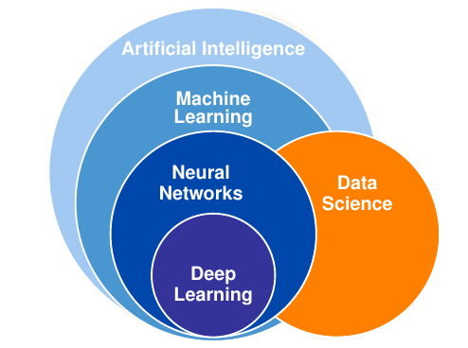
Where in AI sits DL?
AI is a general field that encompasses machine learning and deep learning, but that also includes many more approaches that don’t involve any learning.

Slide 14
AI - ML - DL
AI : Artificial intelligence is the science of making things smart. The aim is make machines perform human tasks. Eg: Robot cleaning a room.
ML : Machine learning is an approach to AI. The machine learns or perform tasks through learning by experience.
DL : Deep Learning is a technique for implementing machine learning to recognise patterns.

Slide 15
Deep (Machine) Learning
Deep learning is a specific subfield of machine learning.
Learning representations from data that puts an emphasis on learning successive layers of increasingly meaningful representations.
The deep in deep learning stands for this idea of successive layers of representations.
The number of layers that contribute to model the data is called the depth of the model.
In deep learning, the layered representations are learned via models called neural networks, structured in literal layers stacked on top of each other.

Slide 16
Why Deep Learning?

Slide 17
Why Deep Learning?
Large amounts of data
Lots and lots of unstructured data like images, text, audio, video
Cheap, high-quality sensors
Cheap computation - CPU, GPU, Distributed clusters
Cheap data storage
Learn by examples
Automated feature generation
Better learning capabilities
Scalability
Advance analytics can be applied

Slide 18
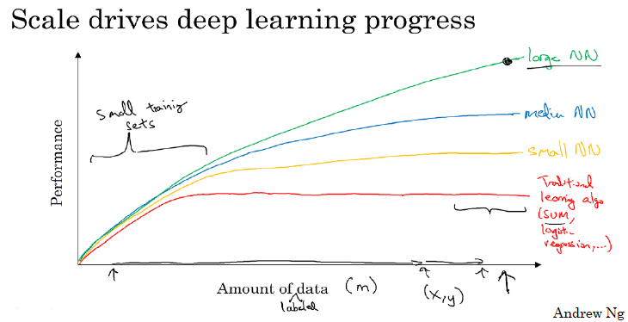
Why deep learning?
Notes:
As the amount of data grows, traditional learning algo do not give better performance. Larger (means deeper) the NN, better the performance, as the amount of data grows.

Slide 19
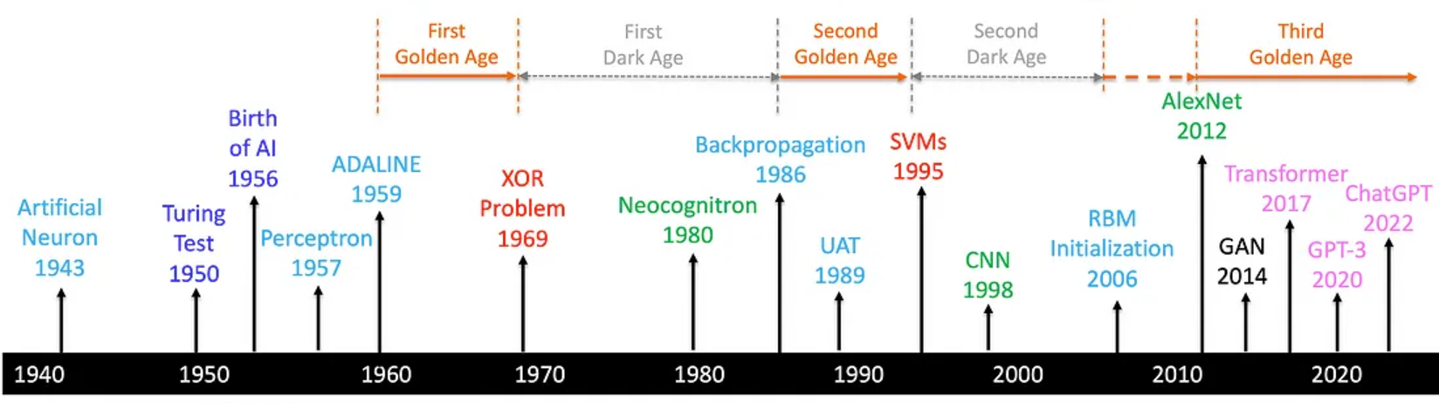
Deep Learning Timeline
Notes:
For reading for the students

Slide 20
Applications of Deep Learning

Slide 21
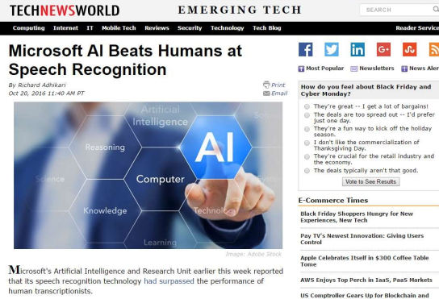
Breakthroughs with Neural Networks
Notes:
Speech recognition using DNN. explain wake word like Alexa, Siri recognition where speech is the input and the app is responding to the query.

Slide 22

Breakthroughs with Neural Networks
Notes:
Translation of text from natural language to another where the input is textual and

Slide 23
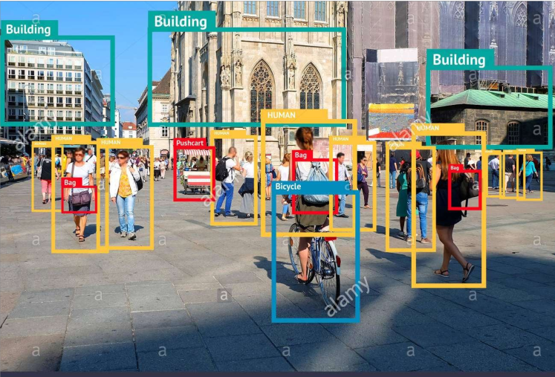
Breakthroughs with Neural Networks
Notes:
Identifying and recognizing various objects in an image. The input is image. OBJECT RECOGNITION

Slide 24
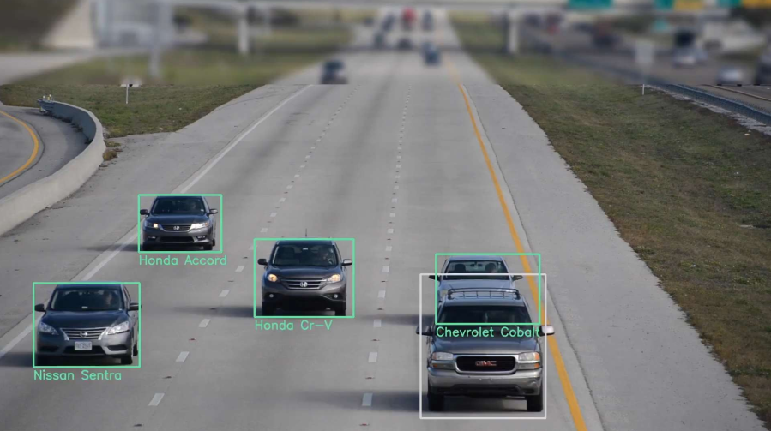
Breakthroughs with Neural Networks
Breakthroughs with Neural Networks
Notes:
Multi object recognition or object with in object.

Slide 25
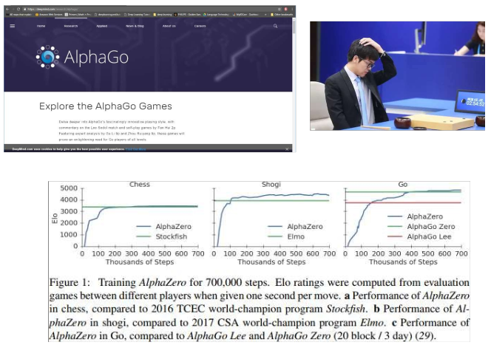
Breakthroughs with Neural Networks
Notes:
In gaming, the DNN out perform the champions. We started with DeepBlue for chess and moved on to AlphaGo.

Slide 26
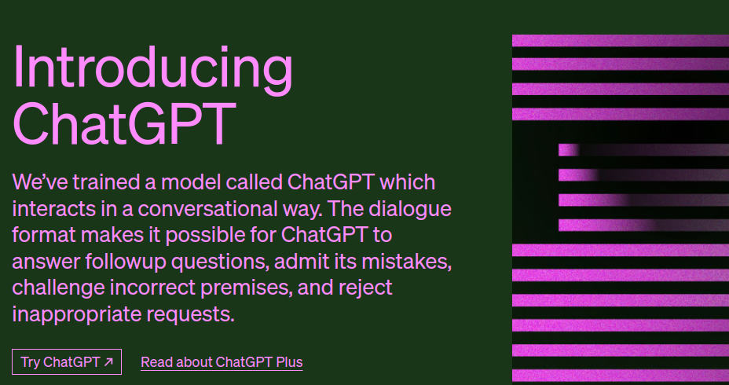
Breakthroughs with Neural Networks
Breakthroughs with Neural Networks
Notes:
Recently Chatgpt making waves using its language models for dialogues.

Slide 27
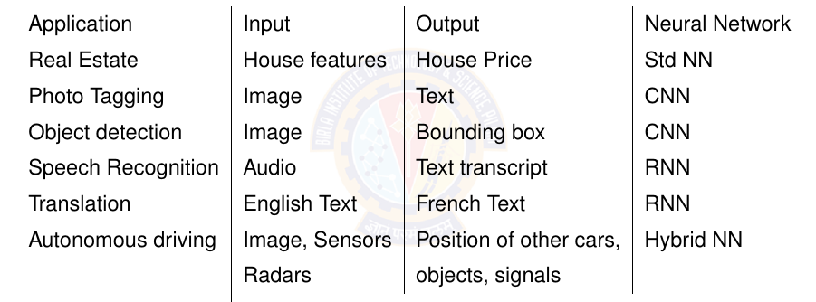
Applications of Deep Learning

Slide 28
Many more applications….
a program that predicts tomorrowʼs weather given geographic information, satellite images, and a trailing window of past weather.
a program that takes in a question, expressed in free-form text, and answers it correctly.
a program that given an image can identify all the people it contains, drawing outlines around each.
a program that presents users with products that they are likely to enjoy but unlikely, in the natural course of browsing, to encounter.
Notes:
Highlight that the input for each of the above are unstructured data like images, text, and web stream clicks. It also involves, looking for a pattern
that changes over time, and we need our programs to adapt. The relationship (say between pixels, and abstract categories) may be too complicated,

Slide 29
Key components of DL problem

Slide 30
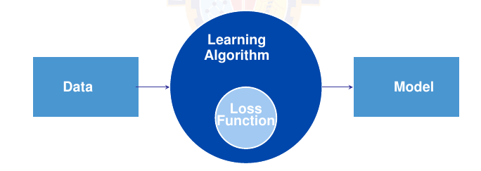
Core components of DL problem
The data that we can learn from.
A model of how to transform the data.
An objective function that quantifies how well (or badly) the model is doing.
An algorithm to adjust the modelʼs parameters to optimize the objective function.
Notes:
Refer to section 1.2. Each point is elaborated in the next slides.

Slide 31
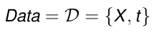
Data
Collection of examples.
Data has to be converted to an useful and a suitable numerical representation.
Each example (or data point, data instance, sample) typically consists of a set of attributes called features (or covariates), from which the model must make its predictions.
In the supervised learning problems, the attribute to be predicted is designated as the label (or target).
Mathematically, a set of m examples,
We need right data.
Notes:
We need the right data. – The data they handle might include bias (from multiple sources) which the model can capture, this can result in undesired consequences.

Slide 32
Data
Dimensionality of data
Each example has the same number of numerical values. This data consist of fixed-length vectors. Eg: Image
The constant length of the vectors as the dimensionality of the data.
Text data has varying-length data.

Slide 33
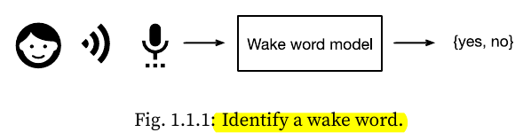
2. Model
Model denotes the computational machinery for ingesting data of one type, and spitting out predictions of a possibly different type.
Deep learning models consist of many successive transformations of the data that are chained together top to bottom, thus the name deep learning.
Notes:
Wake word is Alexa, Hey Siri, Hey Google,
Another example of face recognition where input is image and output is again yes/no. Finger print recognition

Slide 34
3. Objective Function
Learning means improving at some task over time.
A formal mathematical system of learning machines is defined using formal measures of how good (or bad) the models are. These formal measures are called as objective functions.
By convention, objective functions are defined so that lower is better.
Because lower is better, these functions are sometimes called loss functions.
Notes:
You can take any function for which higher is better, and turn it into a new function that is qualitatively identical but for which lower is better by flipping the sign.
squared error is the square of the difference between the prediction and the ground-truth.

Slide 35
3. Loss Functions
To predict numerical values (regression), the most common loss function is squared error.
For classification, the most common objective is to minimize error rate, i.e., the fraction of examples on which our predictions disagree with the ground truth.

Slide 36
3. Loss Functions
Loss function is defined with respect to the model parameters and depends upon the dataset.
We learn the best values of our model parameters by minimizing the loss incurred on a set consisting of some number of examples collected for training. However, doing well on the training data does not guarantee that we will do well on unseen data. I.e Model has to generalize better.
When a model performs well on the training set but fails to generalize to unseen data, we say that it is overfitting.
Notes:
So we will typically want to split the available data into two partitions: the training dataset (or training set, for fitting model parameters) and the test dataset (or test set, which is held out for evaluation), reporting how the model performs on both of them.
You could think of training performance as being like a studentʼs scores on practice exams used to prepare for some real final exam. Even if the results are encouraging, that does not guarantee success on the final exam. In other words, the test performance can deviate significantly from the training performance.

Slide 37
4. Optimization Algorithms
Optimization Algorithm is an algorithm capable of searching for the best possible parameters for minimizing the loss function.
Popular optimization algorithms for deep learning are based on an approach called gradient descent.

Slide 38
Example of the Framework
We have to tell a computer explicitly how to map from inputs to outputs.
We have to define the problem precisely, pinning down the exact nature of the inputs and outputs, and choosing an appropriate model family.
Collect a huge dataset containing examples of audio and label those that do and that do not contain the wake word.

Slide 39
Example of the Framework
Create a Model
Define a flexible program whose behavior is determined by a number of parameters.
To determine the best possible set of parameters, use the data. The parameters should improve the performance of the program with respect to some measure of performance on the task of interest.
After fixing the parameters, we call the program a model.
Eg: The model receives a snippet of audio as input, and the model generates a selection among yes, no as output.
The set of all distinct programs (input-output mappings) that we can produce just by manipulating the parameters is called a family of models.
Eg: We expect that the same model family should be suitable for ”Alexa” recognition and ”Hey Siri” recognition because they seem, intuitively, to be similar tasks.

Slide 40
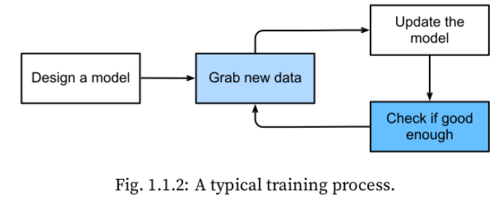
Example of the Framework
The meta-program that uses our dataset to choose the parameters is called a learning algorithm.
In machine learning, the learning is the process by which we discover the right setting of the parameter coercing the desired behavior from our model.
Train the model with
data.

Slide 41
Reading from TB Dive into Deep Learning
Chapter 1
Chapter 2 for Python Prelims, Linear Algebra, Calculus, Probability

Slide 42
Artificial Neural Network

Slide 43
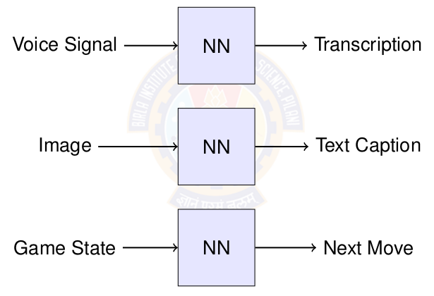
What are Neural Networks?
Notes:
1st block box converts audio signal into transcribed text. Second box writes a caption for what ever is in the image. Third comes with a next move based on some state of a board game like chess or checkers. All these black box do some amount of complex processing that is converts one unstructured data into another unstructured data, whether it si from text to image or from image to text or from one state to another state, These complex problems can be solved using neural networks which are represented in the black boxes. So what does the black box do? What are the made p of? Do the learn if so how?

Slide 44
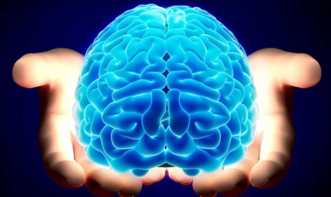
What are Neural Networks?
It begins with human brain.
Humans learn, solve problems, recognize patterns, create, think deeply about something, meditate and many many more.....
Humans learn through association. [Refer to Associationism for more details.]
Notes:
Human brain has the capability to learn, solve problems, recognize patterns, create, think deeply about something, meditate and many many more. We humans learn by observation. This is called as learning through association, in literature.

Slide 45
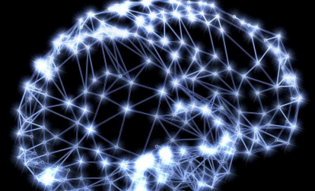
Observation: The Brain
The brain is a mass of interconnected neurons.
Number of neurons is approximately 10^(10).
Connections per neuron is approximately 10^(4 to 5).
Neuron switching time is approximately 0.001 second.
Scene recognition time is 1 second.
100 inference steps doesn't seem like enough. Lot of parallel computation.
Notes:
What is inside the brain? Neurons or neural units. Each unit is excited or fired or triggered based on the input it receives. When see an elephant or when we hear a sound, or smell maggi noodles, some of the neurons are excited and they get fired. Note that only those neurons that respond to smell of maggi noodles get fired. Others are inactive. These neurons that respond to smell, will get fired, and each neuron will produce or generate an apt response that can trigger some actions for the other parts of body like responding with words yummy!!!!

Slide 46
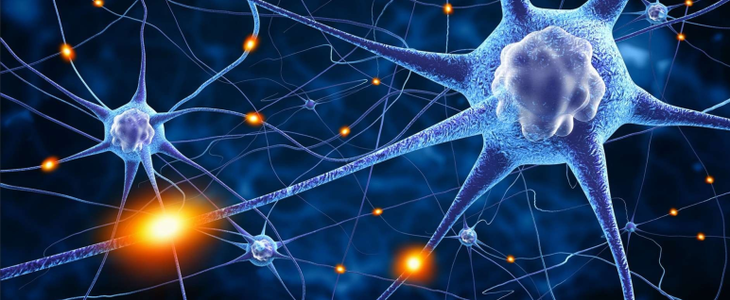
Brain: Interconnected Neurons
Many neurons connect in to each neuron.
Each neuron connects out to many neurons.
Notes:
The neurons in brain are interconnected to a lot of other neurons. The interconnections between the biological neurons are many and varied. Each neuron may receive stimulus from many other neurons. Each neurons will send responses to many other neurons. Even loops between neurons and self loops can be seen among these neurons.

Slide 47

Biological Neuron

Slide 48
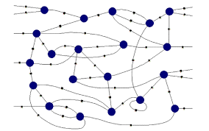
Connectionist Machines
Network of processing elements, called artificial neural unit.
The neurons are interconnected to form a network.
All world knowledge is stored in the connections between these elements.
Neural networks are connectionist machines.
Notes:
The machines that emulate the brain to some extent are called connectionist machines. It is a concept in Artificial intelligence, where each indictila processing element called as neural unit will so some computation. Each unit will receive input from many other units. And each unit will send responses to other neural units. The ideal connectionist machines will have loops and self loops and ll kinds of interconnections imaginable.

Slide 49
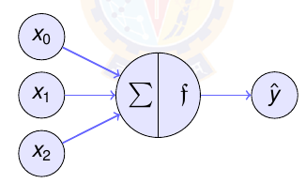
What are Artificial Neurons?
Neuron is a processing element inspired by how the brain works.
Similar to biological neuron, each artificial neuron will be do some computation. Each neuron is interconnected to other neurons.
Similar to brain, the interconnections between neurons store the knowledge it learns. The knowledge is stored as parameters.
Notes:
The artificial neural unit found in the connectionist machine started of as a perceptron. Each neuron will do the computation, which we call as weighted sum. This may be given out as output directly, or we made apply additional processing on the weighted sum before sending the response. The interconnection among the neural unit will store the knowledge of the world. We call the mechanism for storing the knowledge as parameters or weights.

Slide 50
Properties of Artificial Neural Nets (ANNs)
Many neuron-like threshold switching units.
Many weighted interconnections among units.
Highly parallel, distributed process.
Emphasis on tuning parameters or weights automatically.

Slide 51
When to consider Neural Networks?
Input is high-dimensional discrete or real-valued (e.g. raw sensor input).
Possibly noisy data. Data has lots of errors.
Output is discrete or real valued or a vector of values.
Form of target function is unknown.
Human readability, in other words, explainability, of result is unimportant.
Examples:
Speech phoneme recognition
Image classification
Financial prediction

Slide 52
Perceptron

Slide 53
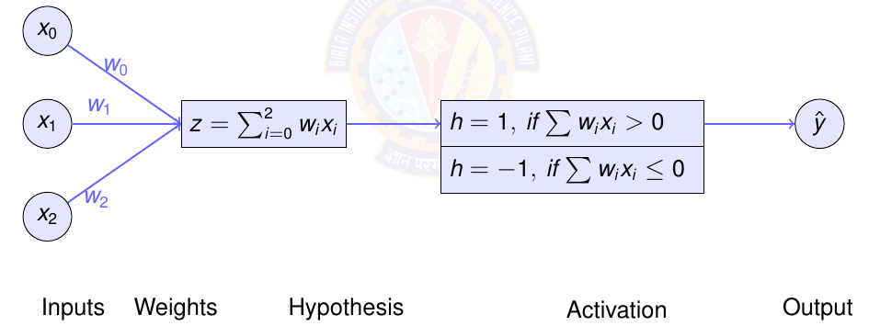
Perceptron
One type of ANN system is based on a unit called a perceptron.
A perceptron takes a vector of real-valued inputs, calculates a linear combination of these inputs, and then outputs a 1 if the result is greater than some threshold and -1 otherwise.
Notes:
Highlight that perceptron will have outputs as +1 and -1 always.

Slide 54
Representing Logic Gates using Perceptron
Perceptron can represent all of the primitive Boolean functions AND, OR, NAND, and NOR – Linearly separable data
some Boolean functions cannot be represented by a single perceptron, such as the XOR function – Linearly nonseparable data
Perceptron learning rule finds a successful weight vector when the training examples are linearly separable, it can fail to converge if the examples are not linearly separable.

Slide 55
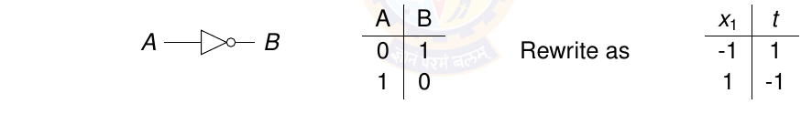
NOT Logic Gate
Question:
How to represent NOT gate using a perceptron?
What are the parameters for the NOT perceptron?
Data is given below.

Slide 56
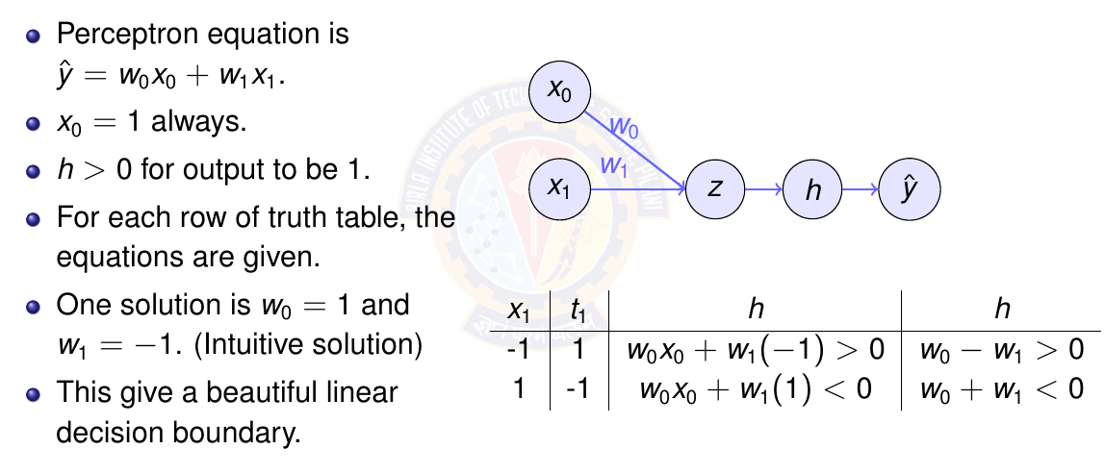
Perceptron for NOT gate
Notes:
2 equations and 2 unknown. Easily solved using linear algebra.

Slide 57
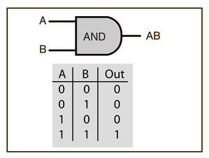
AND Logic Gate
Question:
How to represent AND gate using a perceptron?
What are the parameters for the AND perceptron?
Data is given below.

Slide 58
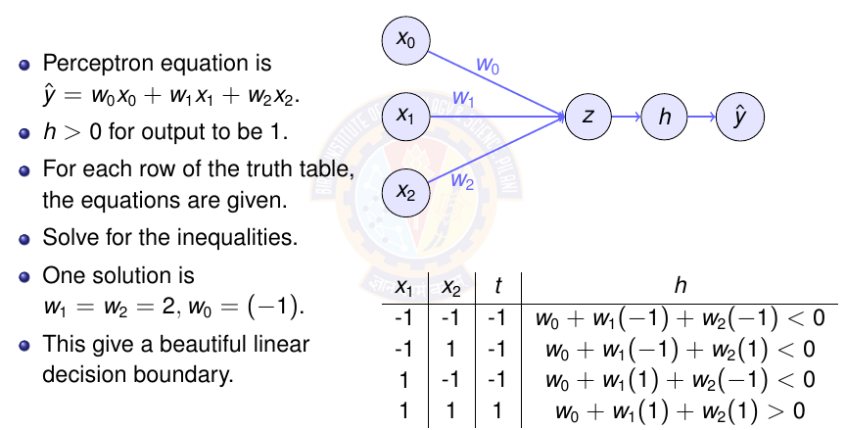
Perceptron for AND gate
Notes:
4 equations and 3 unknown. Easily solved using linear algebra.

Slide 59
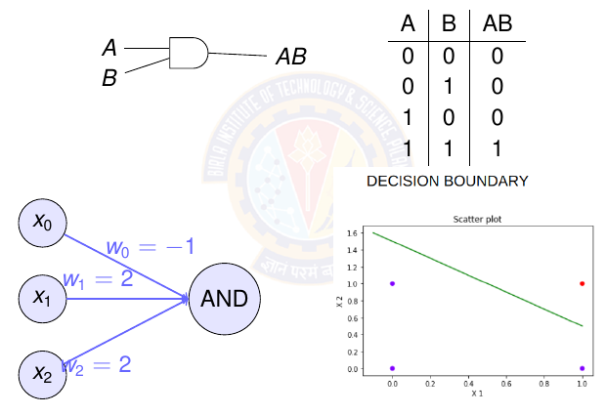
Perceptron for AND gate

Slide 60
Exercise
Represent OR gate using Perceptron. Compute the parameters of the perceptron.
Represent NOR gate using Perceptron. Compute the parameters of the perceptron.
Represent NAND gate using Perceptron. Compute the parameters of the perceptron.
Notes:
Give this as exercise for the students.

Slide 61
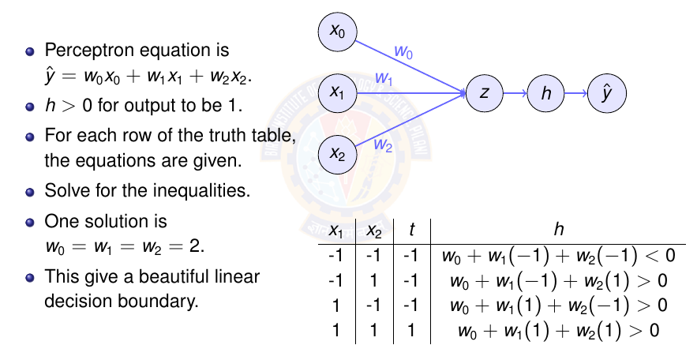
Perceptron for OR gate
Notes:
4 equations and 3 unknown. Easily solved using linear algebra.

Slide 62
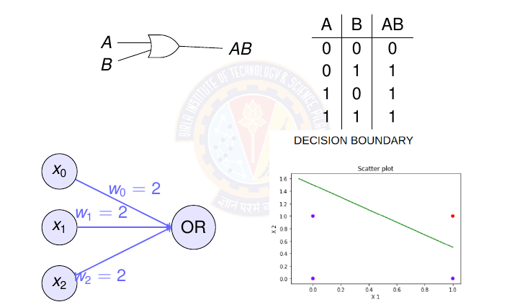
Perceptron for OR gate

Slide 63
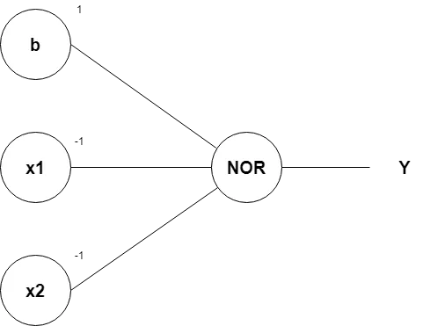
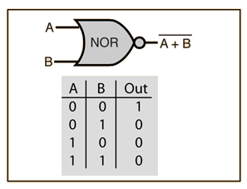
Perceptron for NOR Gate

Slide 64

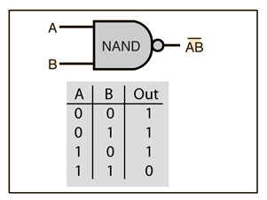
Perceptron for NAND Gate

Slide 65
Perceptron Learning Algorithm

Slide 66
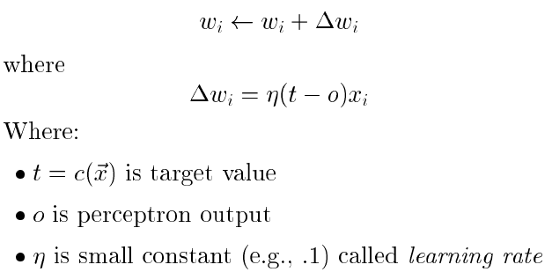
Perceptron Learning Algorithm
Notes:
Definition of learning rate is in next slide

Slide 67
Convergence of Perceptron Learning Algorithm
It can be proved that the algorithm will converge
If training data is linearly separable.
Learning rate is sufficiently small
The role of the learning rate is to moderate the degree to which weights are changed at each step.
It is usually set to some small value (e.g., 0.1) and is sometimes made to decay as the number of weight-tuning iterations increases.
Notes:
linearly separable. (will learn this in upcoming slides)
Learning rate (will learn more about this under Module Optimization)

Slide 68
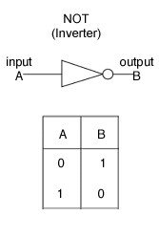
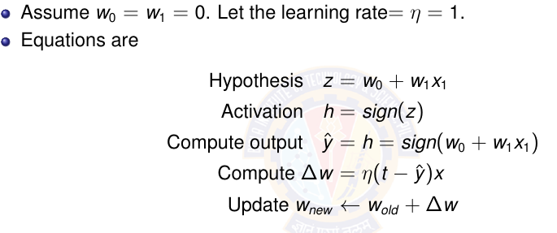
Perceptron Learning Algorithm for NOT gate
Notes:
Highlight the fact that the o(x) equation looks like a line equation y=mx+c. In short we will get a linear decision boundary.

Slide 69
Perceptron Learning Algorithm for NOT gate
w1=w0=0, η =1
X1 | t | W1 | W0 | z | h | Isequal(t,h) | Δw | New w
-1 | 1 | 0 | 0 | 0+0=0 | -1 | No | Δw1=1(1+1)*(-1)=-2 Δw0=1(1+1) =2 | w1🡨 0-2=-2 w0🡨 0+2=2
1 | -1 | -2 | 2 | 2-2=0 | -1 | Yes | Δw1=1(-1+1)1=0 Δw0=1(-1+1) =0 | w1🡨 -2+0=-2 w0🡨 2+0=2
X1 | t | W1 | W0 | z | h | Isequal(t,h) | Δw | New w
-1 | 1 | -2 | 2 | 2+2=4 | 1 | Yes | Δw1=1(1-1)*(-1)=0 Δw0=1(1-1) =0 | w1🡨 -2+0=-2 w0🡨 2+0=2

Slide 70
Demo Python Code
https://colab.research.google.com/drive/1DUVcOoUIWhl8GQKc6AWR1wi0LaMeNkgD?usp=sharing
Student pl note:
The Python notebook is shared for anyone who has access to the link and the access is restricted to use BITS email id. So pl do not access from non-BITS email id and send requests for access.

Slide 71
Exercise
Represent OR gate using Perceptron. Compute the parameters of the perceptron using perceptron learning algorithm.
Represent AND gate using Perceptron. Compute the parameters of the perceptron using perceptron learning algorithm.
Notes:
Give this as exercise for the students.

Slide 72
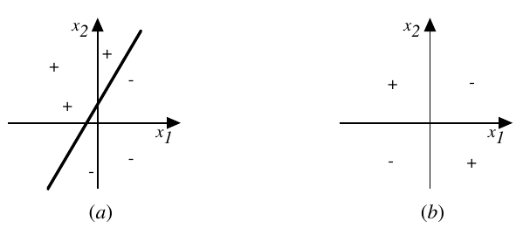
Representational Power of Perceptrons
A perceptron represents a hyperplane decision surface in the n-dimensional space of examples.
The perceptron outputs a 1 for examples lying on one side of the hyperplane and outputs a -1 for examples lying on the other side.
Notes:
The decision surface represented by a two-input perceptron. xl and x2 are the Perceptron inputs. Positive examples are indicated by "+", negative by "-".
Fig( a ) A set of training examples and the decision surface of a perceptron that classifies them correctly.
(b) A set of training examples that is not linearly separable (i.e., that cannot be correctly classified by any straight line).

Slide 73
Single Layer Perceptron
Notes:
Ch 3 of T1

Slide 74
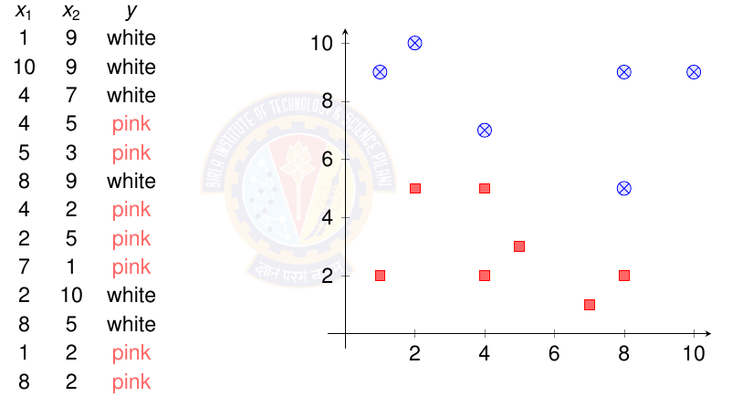
Example of Linearly Separable data
Notes:
Instead of white use 1 and pink as -1

Slide 75
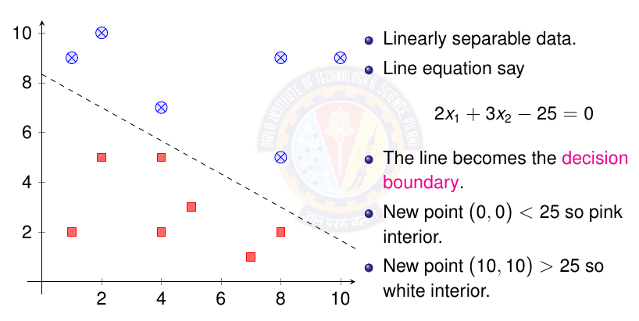
Example of Linearly Separable data
Notes:
The parameters can be learned using perceptron learning algorithm

Slide 76
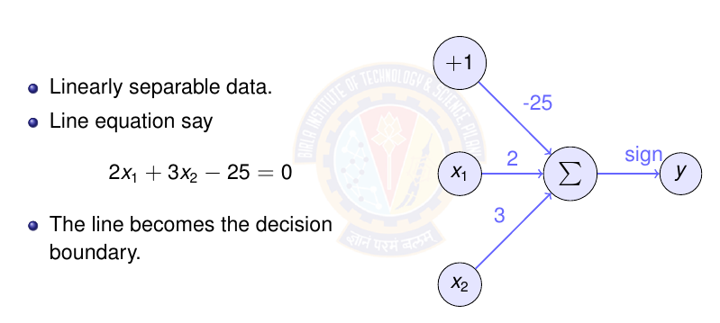
Example of Linearly Separable data

Slide 77
Non-Linearly Separable Data

Slide 78
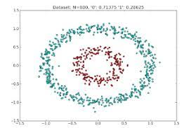
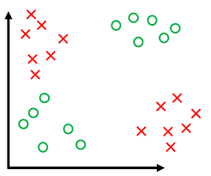
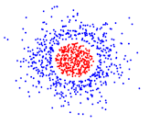
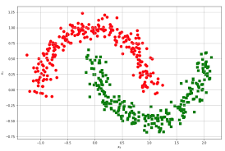
Non-linearly Separable Data
Two groups of data points are non-linearly separable in a 2-dimensional space if they cannot be easily separated with a linear line.

Slide 79
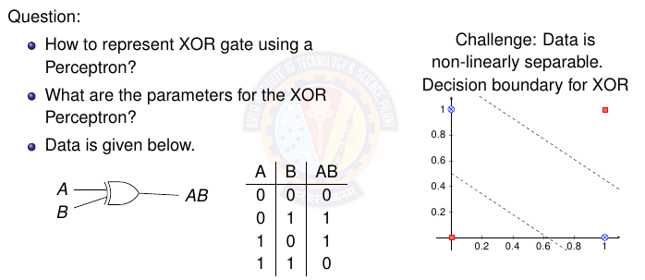
Perceptron for XOR Gate
Notes:
Red dots represent 0 and blue dots represent 1. Need two lines for decision boundary.

Slide 80
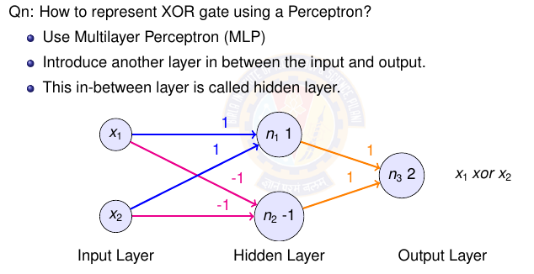
Solution for XOR

Slide 81
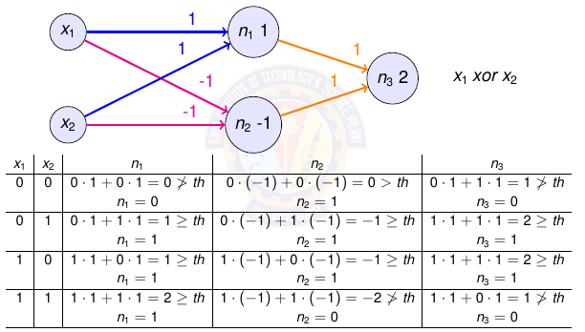
MLP for XOR
Notes:
The rule is weighted sum >= threshold, output is 1.
Encourage students to do for other inputs.

Slide 82
Ref:
Chapter 4 of Book: Machine Learning by
Tom M. Mitchell

Slide 83
Thank You All !

